Slide 1

BPCI Twitter Data Analysis and Monitoring Demonstration
September 27, 2019

Slide 2
What We Have Done
Extracted data on past BPCI tweets
Conducted exploratory analysis based on historical data to inform what to monitor going forward
Determined feasibility/usefulness of different analyses
Created draft GUI for monitoring tool

Slide 3
Meeting Purpose
Present what we found in historical data
Brainstorm what to monitor for going forward
Talk next steps for monitoring tool

Slide 4
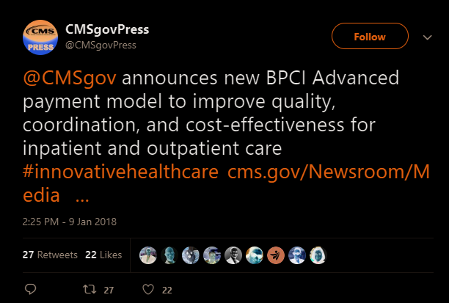
Historical Data
Purpose: Extract data on all tweets related to BPCIA
“BPCIA related” tweet definition:
Dated Jan 9,2018 - Present
Text contains “BPCI Advanced” or variation
Found ~2,700 tweets in 21 months

Slide 5
General Monitoring Tool
On demand, the tool will easily:
Rerun extraction to retrieve any new tweets related to BPCIA
Update any of the analyses we present with new data
Update the analysis displays in the GUI

Slide 6
Areas of Analysis
Reaction Timing/Speed
Level/Variety of Engagement
Geographic Analysis
Content Analysis

Slide 7
Area 1. Reaction Timing/Speed

Slide 8
Area 2. Level/Variety of Engagement

Slide 9
Area 3. Geographic Analysis
Analysis Summary
Limited tweet geolocation data
Sophisticated geospatial analysis not really feasible
580 of 2723 (21%) tweets had geolocation data
Mostly U.S. eastern seaboard cities

Slide 10
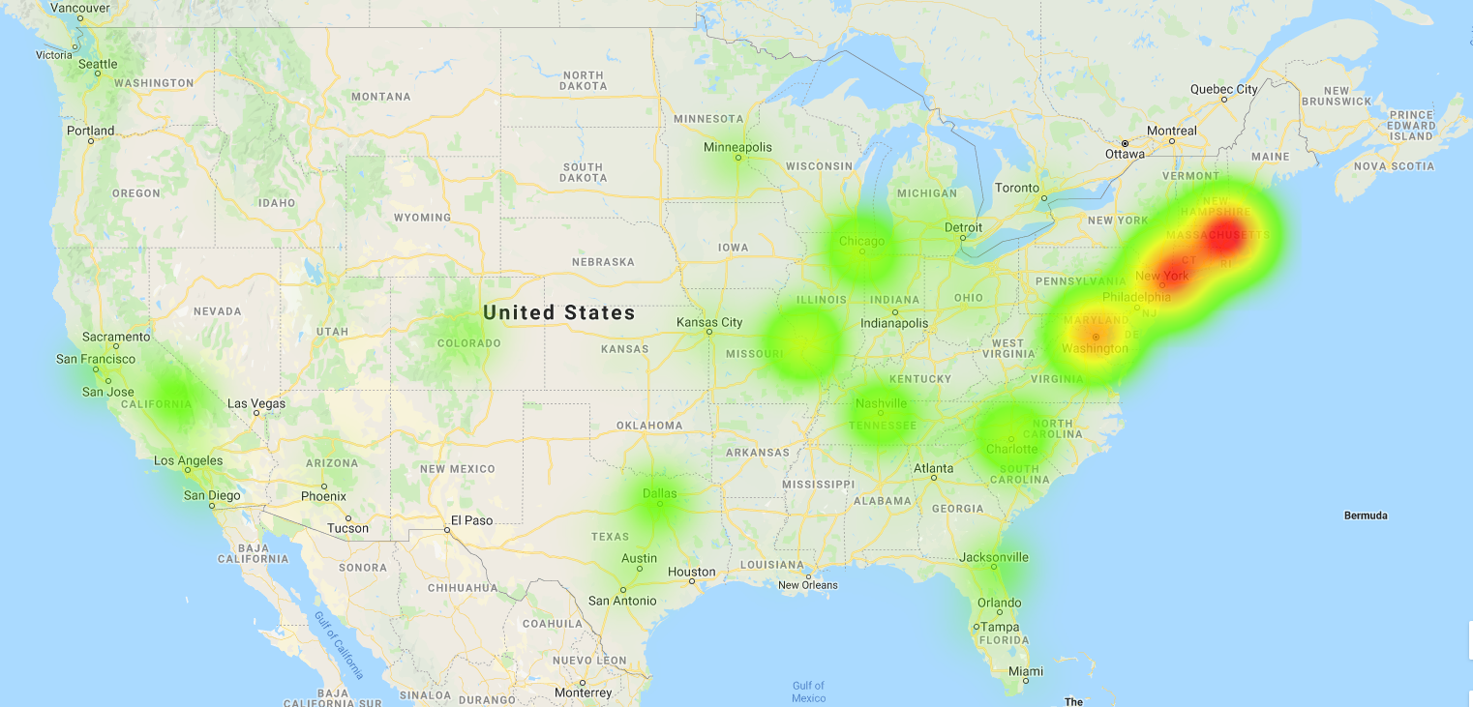
Area 3. Geographic Analysis

Slide 11
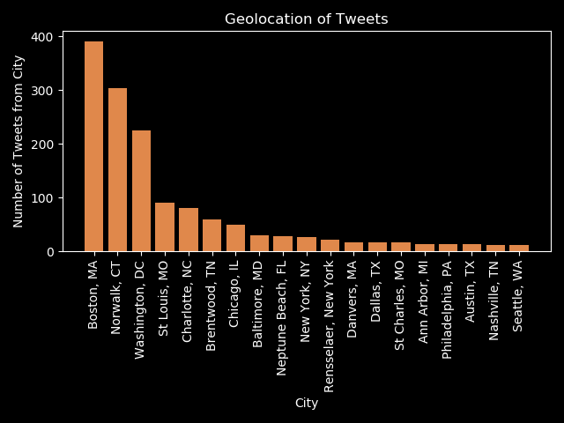
Area 3. Geographic Analysis

Slide 12
Area 3. Geographic Analysis
Monitoring Possibilities
On-demand update and reproduction
Automated anomaly alerts when recent tweets are coming in from cities different than in the past

Slide 13
Area 4. Content Analysis
Analysis Summary
Not a ton of substantive discussion of issues in tweets
Most tweets were advertisements for articles/webinars about BPCIA, but didn’t contain substantive language
As a result, NLP methods produced pretty noisy results that can be difficult to interpret

